Slide 1
Exploration of NYT with NLP
By:
Lisa Patel
Ailene Nguyen
Pratiksha Raval
Mukesh Ganesh
Vishakha Srivastava

Slide 2
Agenda
About NYT Dataset
Introducing the Problem
Data Cleaning and Preparation
Exploratory Data Analysis on comments and articles
Sentiment Analysis
Text Summarization
Auto-Text Generation

Slide 3

Our Dataset
Articles and comments in New York Times between Jan-May 2017 and Jan-April 2018
Over 2 million comments with 34 features
Features: approveDate, commentBody, commentID, commentSequence, commentTitle, commentType, createDate, depth, editorsSelection, inReplyTo, replyCount, recommendations, etc.
Over 9,000 articles with 16 features
Features: articleID, abstract, byline, documentType, headline, keywords, multimedia, newDesk, printPage, pubDate, sectionName, snippet, source, typeOfMaterial, webURL, articleWordCount

Slide 4
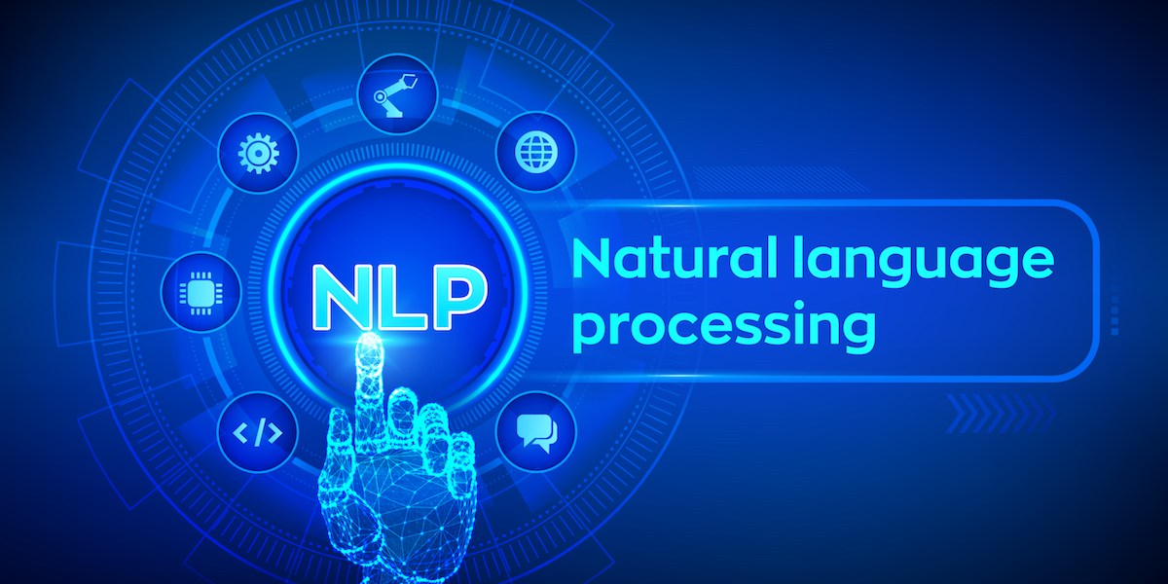
Introducing the Problem
Too much textual data → Text Summarization
Texts have a huge influence on society → Sentiment Analysis
Guessing the intended future statements → Auto-Text Generation
Our Solution: Natural Language Processing (NLP)

Slide 5
Explaining the Process
Step 1
Step 2
Step 3
Data Preparation and Cleaning
Web Scraping
Text Cleaning
Corpus + Document Term Matrix
Exploratory Data Analysis
Visualization
Insights
Trends + Patterns
Build Models
Sentiment Analysis
Predicting NYT’s Pick
Text Summarization
Auto-Text Generation

Slide 6
Data Preparation and Cleaning

Slide 7

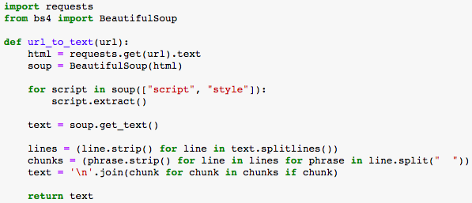
Web Scraping
Libraries: requests, BeautifulSoup
pip install beautifulsoup4

Slide 8
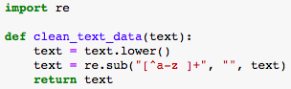
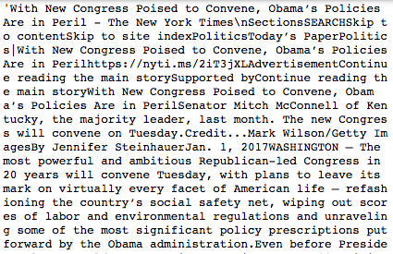
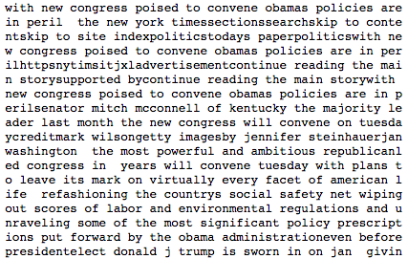
Text Cleaning
Module: re (regular expressions)
Before:
After:

Slide 9
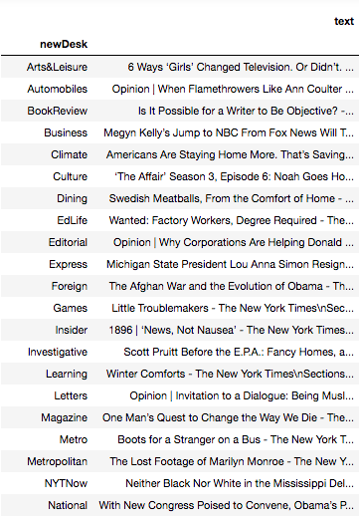
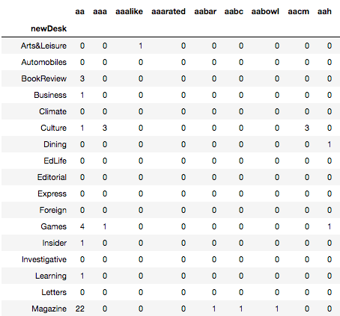
Corpus + Document-Term Matrix
Corpus:
Document-Term Matrix:

Slide 10
Exploratory Data Analysis
On articles

Slide 11
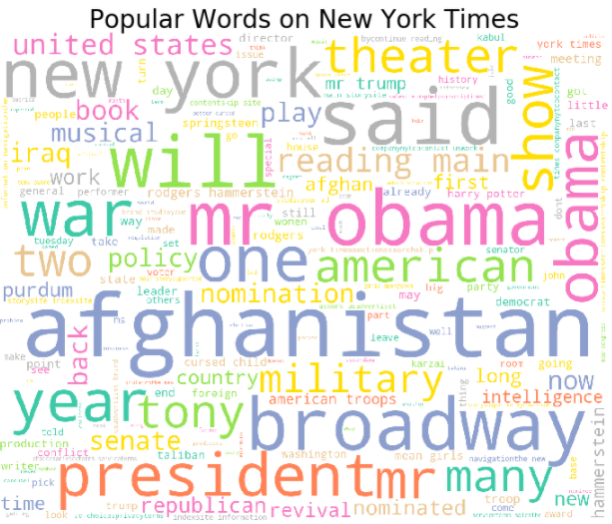
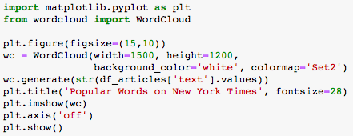
Visualization
Matplotlib and WordCloud!

Slide 12
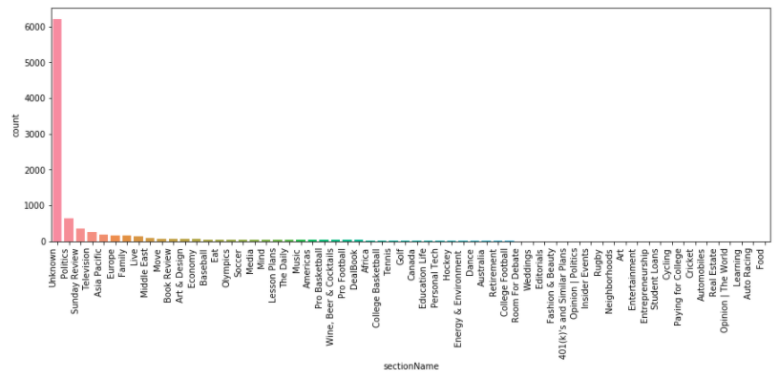
Visualizing sectionName
Most articles are in the “Unknown” category of sectionName

Slide 13
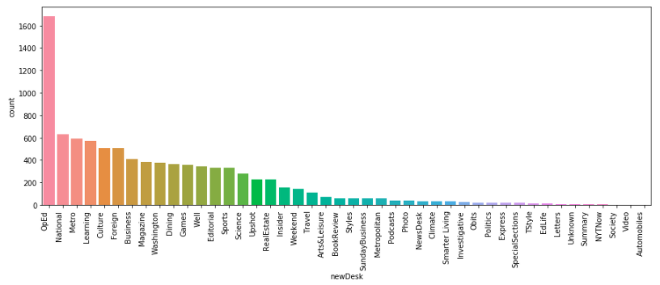
Visualizing newDesk
Better distribution of values in newDesk, most are in the “OpEd” category
→ Analysis of text grouped by newDesk

Slide 14
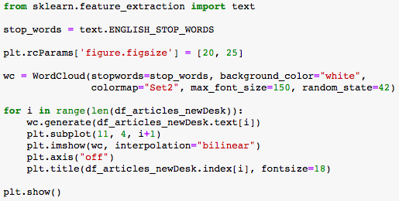
More WordClouds
Define stop words using sklearn.feature_extraction.text.ENGLISH_STOP_WORDS
I.e. ‘a’, ‘i’, ‘it’, ‘me’, ‘my’, ‘the’, etc.

Slide 15
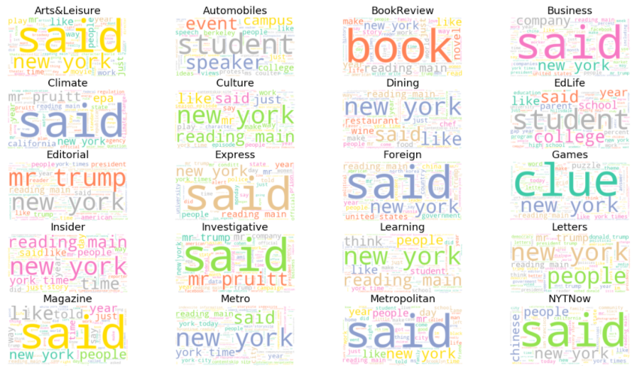
Text still needs more cleaning! → Words such as “like” or “said” that are high in frequency but provide little insight should be removed for further analysis
Notes:
Note: there is 44 total newDesk word clouds but for presentation purposes, only 20 are shown above

Slide 16
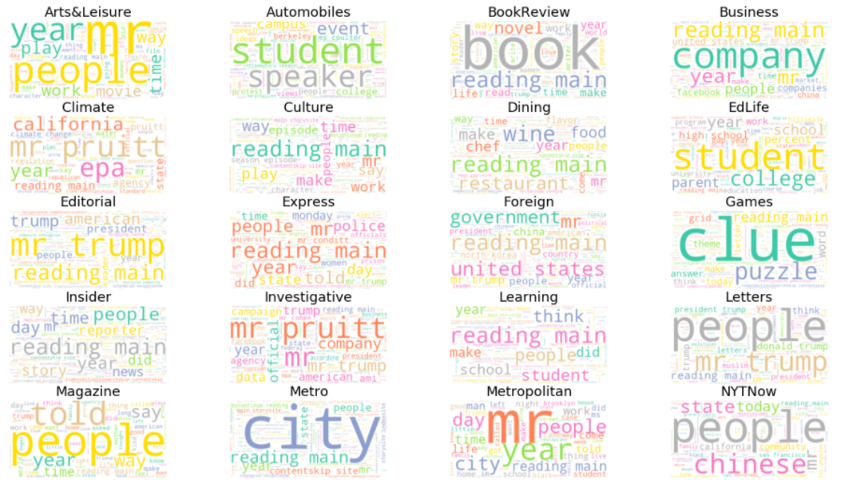
Do the resulting WordClouds make sense? What insight can we gain from them?

Slide 17
Exploratory Data Analysis
On comments

Slide 18
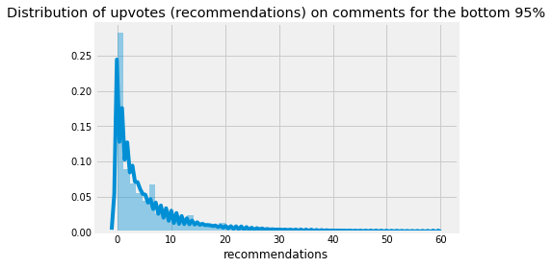
Visualizing Distribution of upvotes on comments

Slide 19
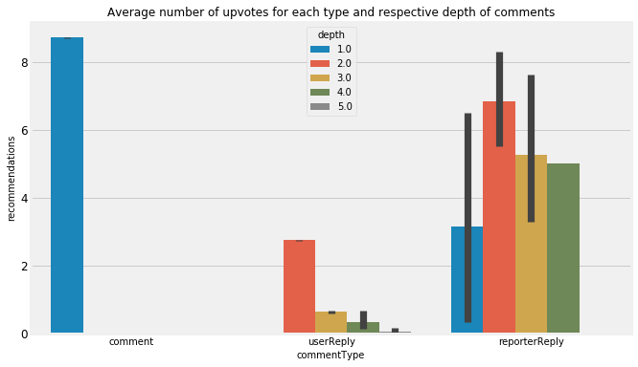
Upvotes for each comment type and depth of comments
Even though ‘comment’ has more upvotes, ‘reporterReply’ has more depth in the comments

Slide 20
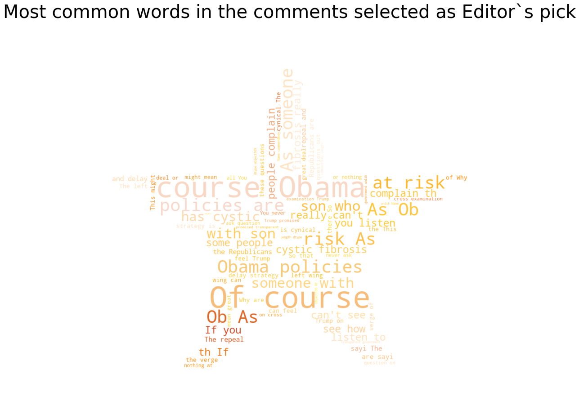
WordCloud for comments

Slide 21
Sentiment Analysis

Slide 22

Sentiment Analysis
What is it?
Seeks to quantify the emotional intensity of words and phrases within a text.
Where is it used?
To help businesses make sense of unorganized data.
positive
neutral
negative

Slide 23
Natural Language Toolkit (NLTK)
TextBlob:
Input: corpus
Scores:
polarity (scale of -1 to 1)
subjectivity (scale of 0 to 1)
VADER (Valence Aware Dictionary and sentiment Reasoner)
Input: corpus
Scores:
compound (scale of -1 to 1)
positive (scale of 0-1)
neutral (scale of 0-1)
negative (scale of 0-1)

Slide 24
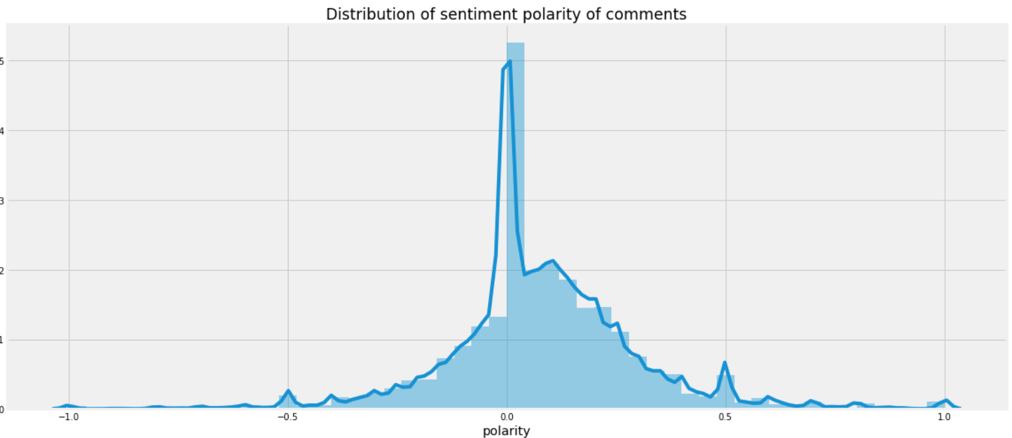
Results: TextBlob
Conclusion: The tone of the comments here is tending towards positive side.

Slide 25
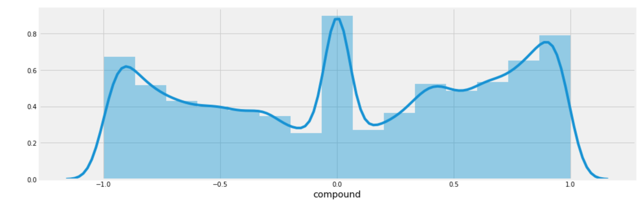
Results: VADER
Conclusion: The comments have balanced sentiments (negative and positive)

Slide 26
What affects the scores?
Punctuations - The use of an exclamation mark(!), increases the magnitude of the intensity. Eg: The food here is good!!!
Capitalization- Using upper case letters to emphasize a sentiment-relevant word in the presence of other non-capitalized words, increases the magnitude.
Conjunctions - Use of conjunctions like “but” signals a shift in sentiment polarity. Eg: The food here is great but the service is horrible.

Slide 27
Predicting NYT’s Editor’s pick

Slide 28
Steps
Importing modules and data
Balancing the classes to some extent by undersampling the majority class.
Obtaining and combining the tf-idf vectors for words and character n-grams using TFIDFVectorizer and FeatureUnion.
Training the first classifier that uses Logistic Regression coupled with Latent Semantic Analysis (LSA).
Training the second classifier that uses NB-Logistic Regression model.
Comparing the two classifiers by plotting the ROC and Precision-Recall curve.

Slide 29
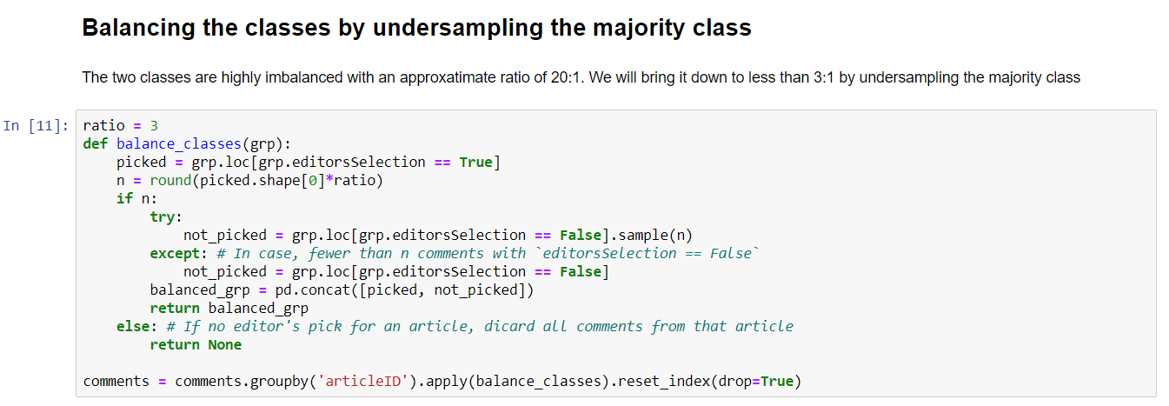
Balancing the classes

Slide 30
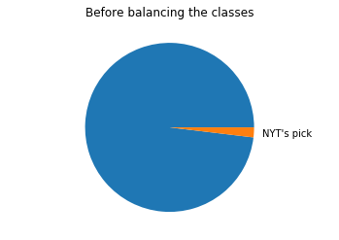
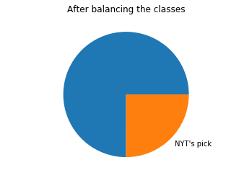
Balancing the classes

Slide 31
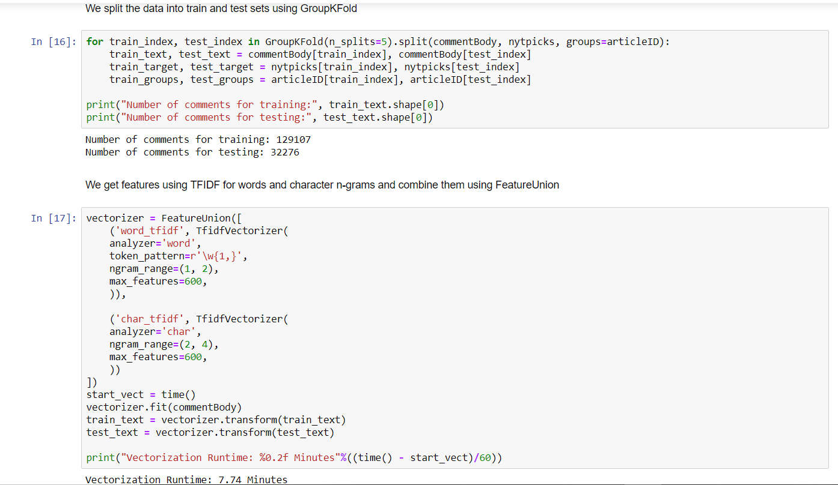
Splitting the data using GroupKFold
We use GroupKFold to split the data into train and test sets such that the two sets have comments from disjoint set of articles. Here we used 5 splits for the GroupKFold

Slide 32
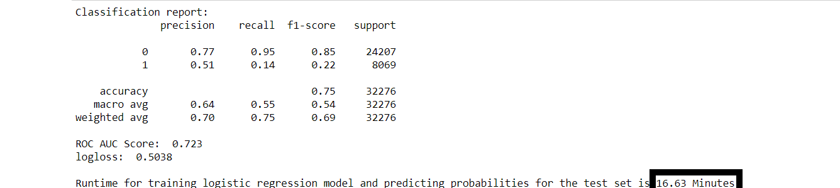
Logistic Regression coupled with Latent Semantic Analysis (LSA)

Slide 33
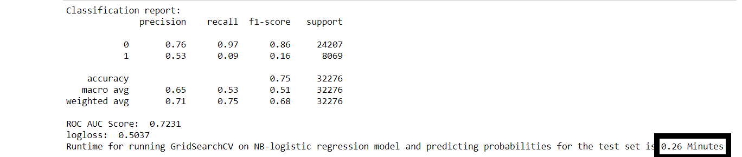
NB-Logistic Regression model

Slide 34
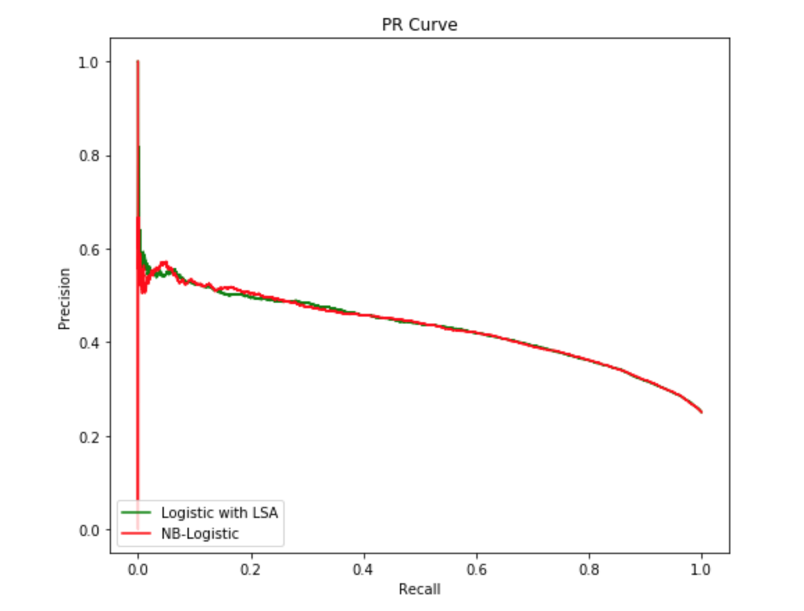
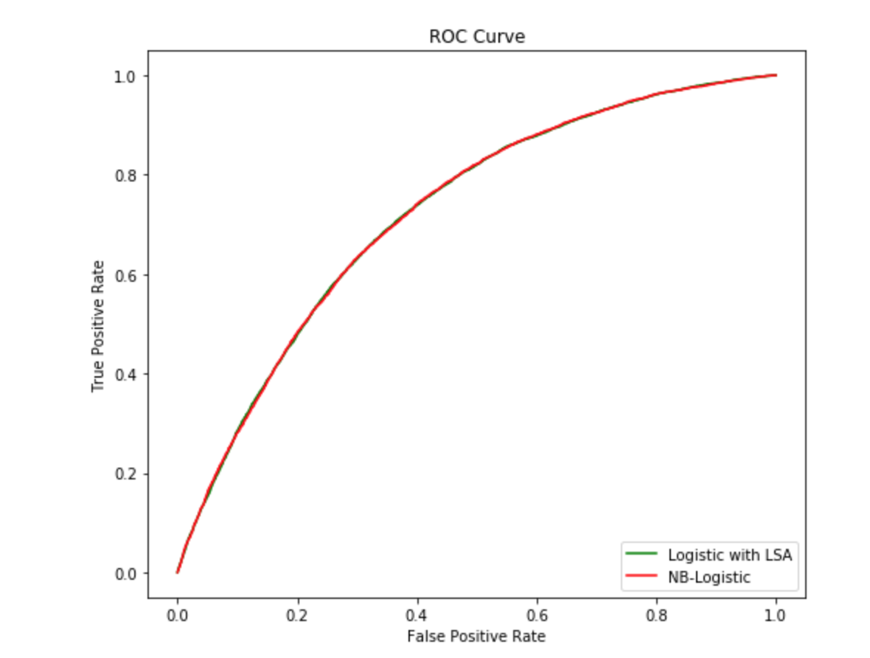
Precision Recall Curve ROC Curve
Conclusion: Both models seem to have performed equally well but the time taken by the NB Logistic model is very less compared to Logistic Regression coupled with LSA

Slide 35
Text Summarization

Slide 36
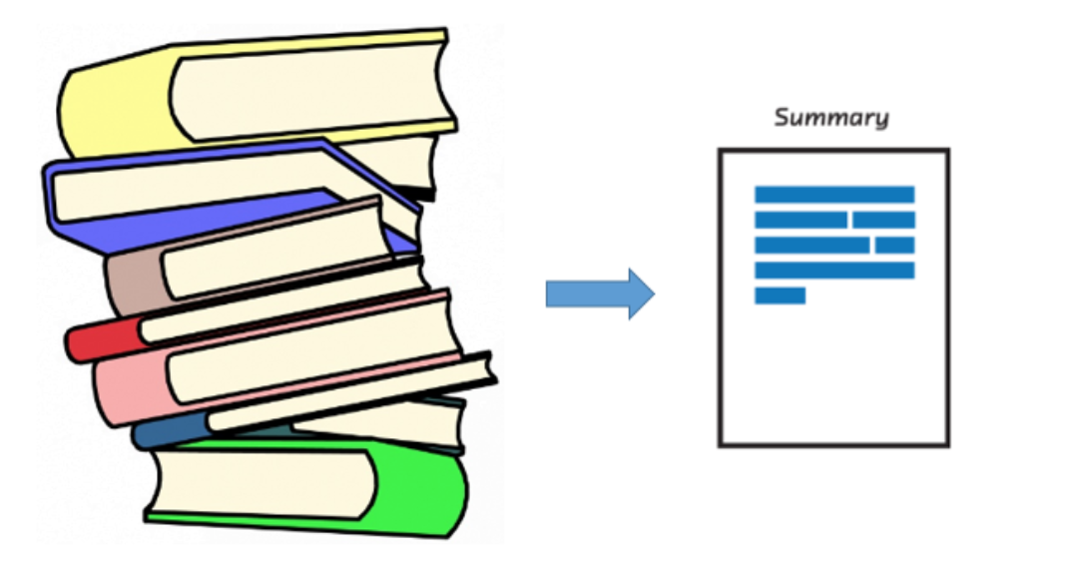
Understanding the Problem
New Articles can often be long and descriptive. Analyzing these articles manually, as you can imagine, is really time-consuming. This is where the brilliance of Natural Language Processing can be applied to generate a summary for long articles.
We will be working on the NY Times Articles. Our objective here is to generate a summary for the NY Times articles using the extraction-based approach.

Slide 37
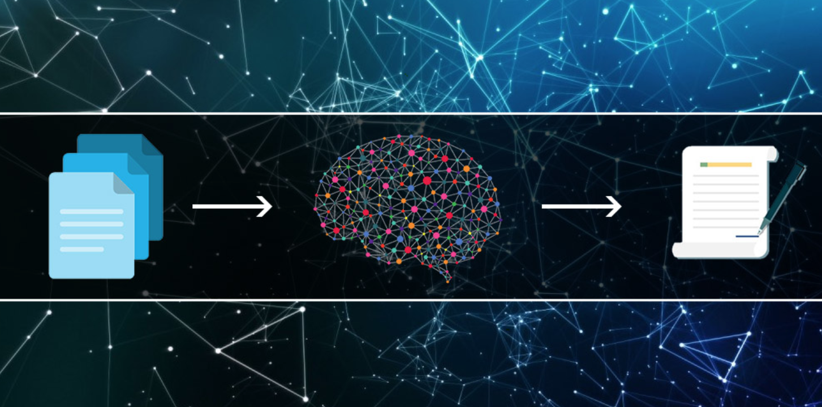
What is Text Summarization in NLP?
“Automatic text summarization is the task of producing a concise and fluent summary while preserving key information content and overall meaning”
- Text Summarization Techniques:
A Brief Survey
There are broadly two different approaches that are used for text summarization:
· Extractive Summarization
· Abstractive Summarization

Slide 38
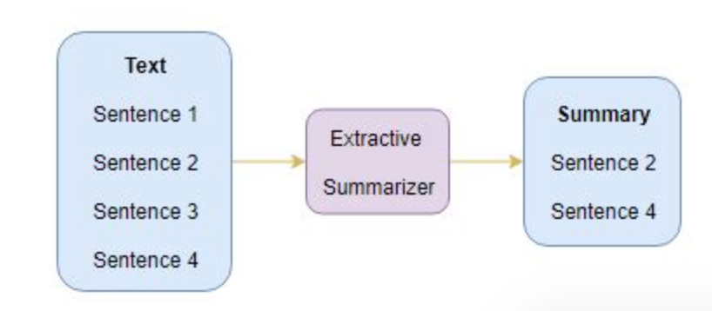
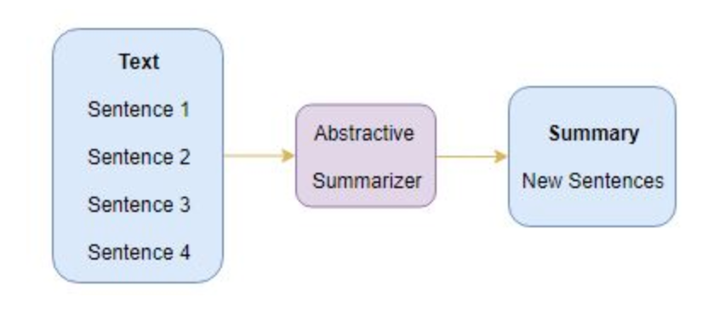
Summarization Approaches
Extractive Summarization
The name gives away what this approach does. We identify the important sentences or phrases from the original text and extract only those from the text. Those extracted sentences would be our summary. The below diagram illustrates extractive summarization:
Abstractive Summarization
These methods uses advanced NLP techniques to generate new sentences from the original text. This is in contrast to the extractive approach, where we used only the sentences that were present. The sentences generated through abstractive summarization might not be present in the original text.

Slide 39
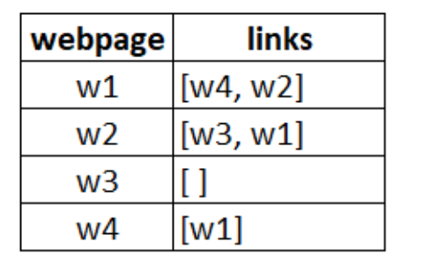
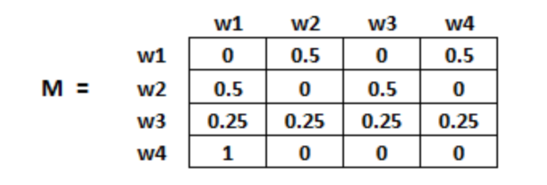
TextRank Algorithm
Graph-based ranking algorithms are essentially a way of deciding the importance of a vertex within a graph, based on global information recursively drawn from the entire graph. The basic idea implemented by a graph-based ranking model is that of “voting” or “recommendation”
Example:
The initialization of the probabilities is explained in the steps below:
Probability of going from page i to j, i.e., M[ i ][ j ], is initialized with 1/(number of unique links in web page wi)
If there is no link between the page i and j, then the probability will be initialized with 0
If a user has landed on a dangling page, then it is assumed that he is equally likely to transition to any page. Hence, M[ i ][ j ] will be initialized with 1/(number of web pages)

Slide 40
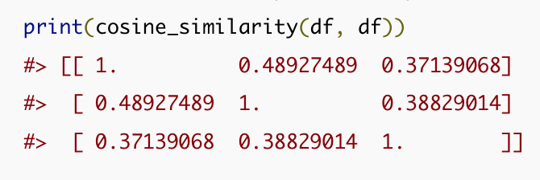
Similarity Matrix
A widely used measure in Natural Language Processing is the Cosine Similarity. The Cosine Similarity computes the cosine of the angle between 2 vectors. If the vectors are identical, the cosine is 1.0. If the vectors are orthogonal, the cosine is 0.0.
Example:
Doc Trump (A) : Mr. Trump became president after winning the political election. Though he lost the support of some republican friends, Trump is friends with President Putin.
Doc Trump Election (B) : President Trump says Putin had no political interference is the election outcome. He says it was a witch hunt by political parties. He claimed President Putin is a friend who had nothing to do with the election.
Doc Putin (C) : Post elections, Vladimir Putin became President of Russia. President Putin had served as the Prime Minister earlier in his political career.
Since, Doc B has more in common with Doc A than with Doc C, we would expect the Cosine between A and B to be larger than (C and B).

Slide 41
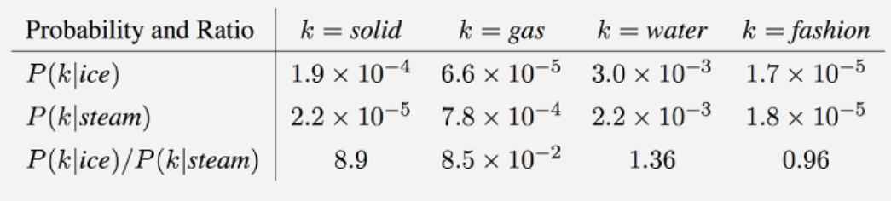
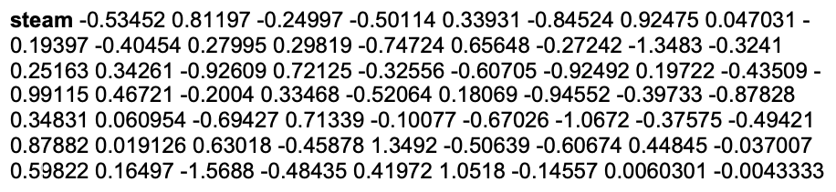
GloVe Vectors
GloVe is an unsupervised learning algorithm for obtaining vector representations for words.
Model Overview
GloVe is essentially log-bilinear model with a weighted least-squares objective. The main intuition underlying the model is the simple observation that ratios of word-word co-occurrence probabilities have the potential for encoding.
Example:
GloVe text file:
Each word will be associated to 100 co-relational values
Notes:
Training is performed on aggregated global word-word co-occurrence statistics from a corpus, and the resulting representations showcase interesting linear substructures of the word vector space.
For example, consider the co-occurrence probabilities for target words ice and steam with various probe words from the vocabulary. Here are some actual probabilities from a 6 billion word corpus:
As one might expect, ice co-occurs more frequently with solid than it does with gas, whereas steam co-occurs more frequently with gas than it does with solid. Both words co-occur with their shared property water frequently, and both co-occur with the unrelated word fashion infrequently. Only in the ratio of probabilities does noise from non-discriminative words like water and fashion cancel out, so that large values (much greater than 1) correlate well with properties specific to ice, and small values (much less than 1) correlate well with properties specific of steam. In this way, the ratio of probabilities encodes some crude form of meaning associated with the abstract concept of thermodynamic phase.

Slide 42
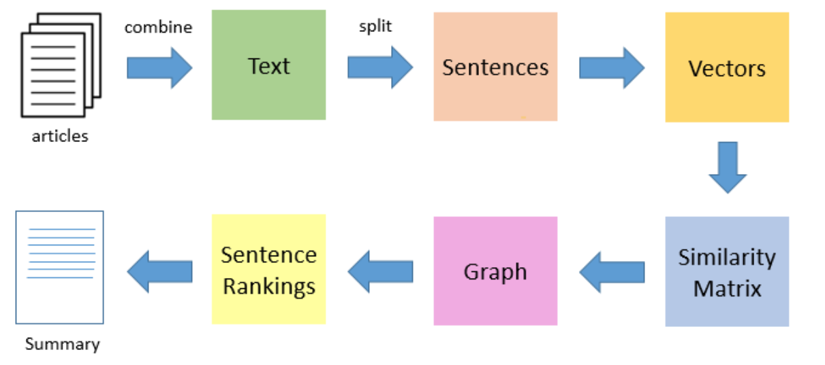
Steps
Data collection from web through web-scraping
Data Cleanup (remove special characters, numeric values, stopwords, punctuations)
Tokenization - Creation of tokens (Sentences tokens)
Find vector representation (word embeddings) for each and every sentence
Build Similarity matrix with calculated sentence vectors
Similarity matrix is converted to graph using Pagerank, where sentences will be vertices and similarity score as edges.
Calculate sentence ranks
Creation of summary with top N highest scored sentences

Slide 43
Auto-Text Generation

Slide 44

Neural Network
Natural Language Processing (NLP)
Neural Networks are set of algorithms which closely resemble the human brain and are designed to recognize patterns.
Natural language processing is necessary for tasks like the classification of word documents or the creation of a chatbot.

Slide 45
Two ways to tackle NLP task
Word-level Text Generation
Character-level Text Generation
Display higher accuracy
Form shorter representations of sentences
Quicker to train the model
Less memory required

Slide 46
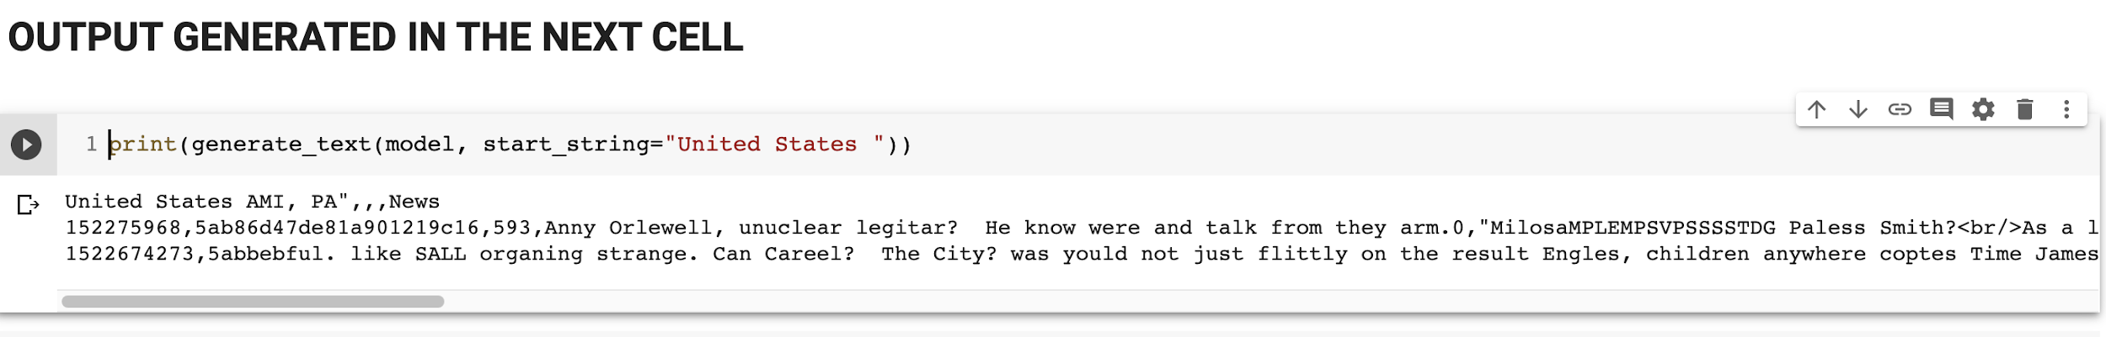
Output for Character-level Text Generation

Slide 47
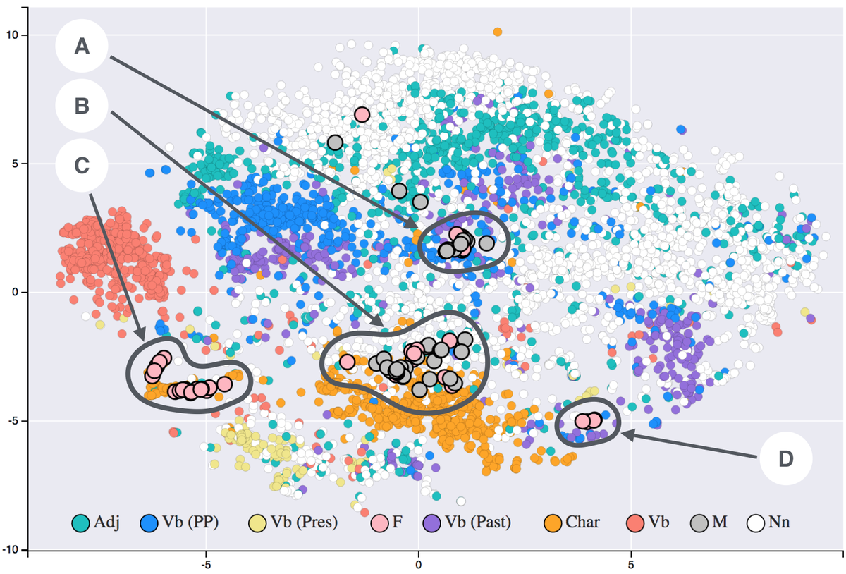
Word Embeddings
Represents words or phrases as a vector of real numbers
Similar to one-hot encoding
But uses more numbers than simply ones and zeros
Therefore it can form more complex representations

Slide 48

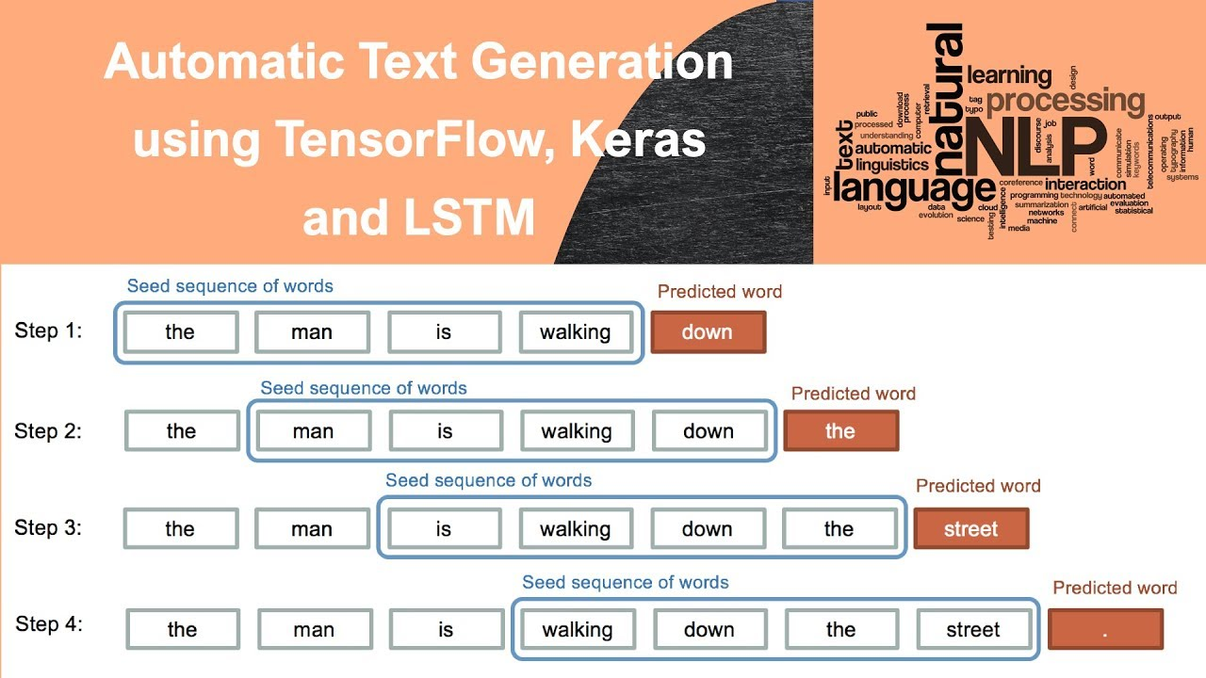
TensorFlow and Keras
TensorFlow
One of the most commonly used machine learning libraries specializing in the creation of deep neural networks
Keras
Uses TensorFlow's functions and abilities
Makes building a neural network much simpler and easier

Slide 49
Recurrent Neural Network (RNN)
A generalization of feedforward neural network with internal memory.
Recurrent in nature
Advantages
Model size not increasing with size of input
Computation takes into account historical information
Disadvantages
The longer the input series is, the more the network "forgets"
Computation is slow

Slide 50
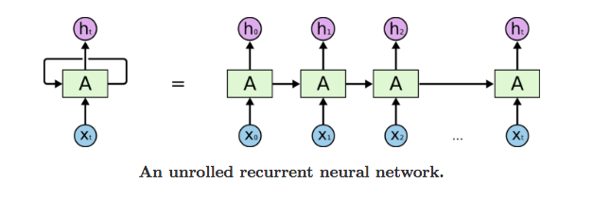
How RNN works?
First step, Input → X(0) Output → h(0)
Second step, Input → h(0), X(1) Output → h(1)
Third step, Input → h(1), X(2) Output → h(2)
And so on.
This way, it keeps remembering the context while training.

Slide 51
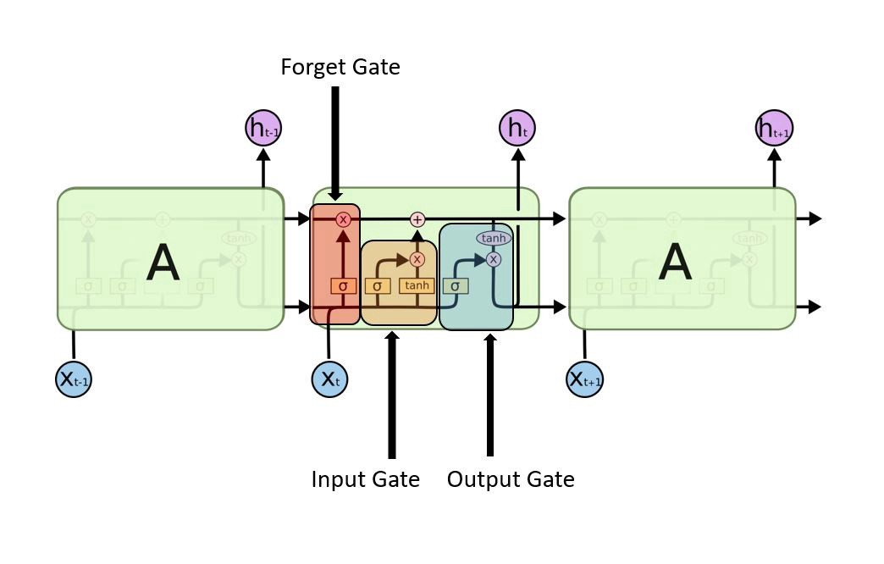
LSTM
A modified version of recurrent neural networks
Makes it easier to remember past data in memory
Input Gate
Discover which value from input should be used to modify the memory
Forget Gate
Discover what details to be discarded from the block
Output Gate
The input and the memory of the block is used to decide the output
Notes:
https://medium.com/@kangeugine/long-short-term-memory-lstm-concept-cb3283934359

Slide 52
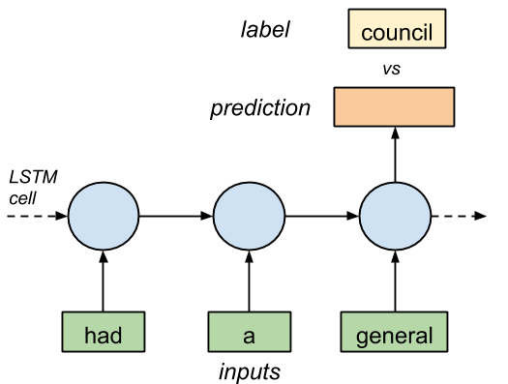
If we feed a LSTM with correct sequences from the text of 3 symbols as inputs and 1 labeled symbol, eventually the neural network will learn to predict the next symbol correctly
Technically, LSTM inputs can only understand real numbers. A way to convert symbol to number is to assign a unique integer to each symbol based on frequency of occurrence

Slide 53
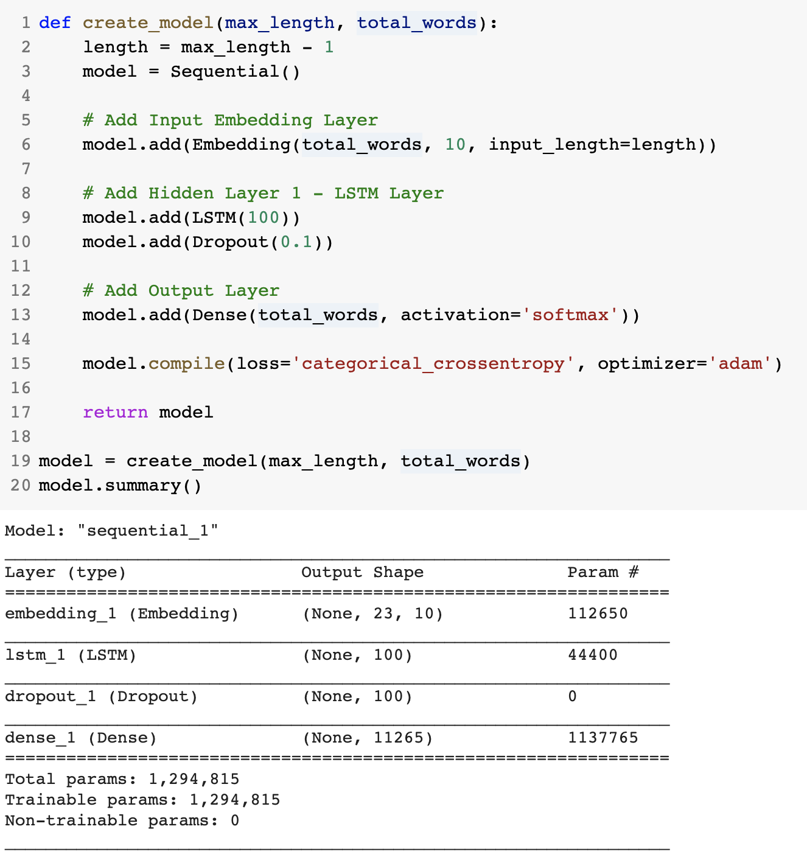
Explanation of the algorithm
The idea is to train the RNN with many sequences of words and the target next_word.
Example:
If each sentence is a list of five words, then the target is a list of only one element, indicating which is the following word in the original text

Slide 54
Thank you!

